Slide 1

PeopleSoft ERP
FSCM 9.2 UPGRADE
Optum ERP Project Costing Changes

Slide 2

Agenda
Introductions
Objectives
Schedule
Fit Gap
Business Process Deltas between 9.1 and 9.2
Confirm new functionality that should be explored for system design
Customizations
Retrofit / Eliminate
Interfaces
Retrofit / Eliminate
Reports
Retrofit / Eliminate
Security
Discussion

Slide 3
Introductions
Name
Functional Area
Role

Slide 4
Objectives
An overview of New or updated features in PeopleSoft Project costing 9.2 release
Identify Gaps
Confirm Inventory of Interfaces, Customizations and Reports
Determine the Impacts on current business processes
Facilitate the next stage – Upgrade A&D Project

Slide 5
Schedule
Date | Time | Topic
09/13/2016 | 9 AM – 11 AM (CST) | Business Modeling Session 1: Project Costing
09/15/2016 | 9 AM – 11 AM (CST) | Business Modeling Session 2: Project Costing

Slide 6

PeopleSoft 9.2 Global Enhancements

Slide 7
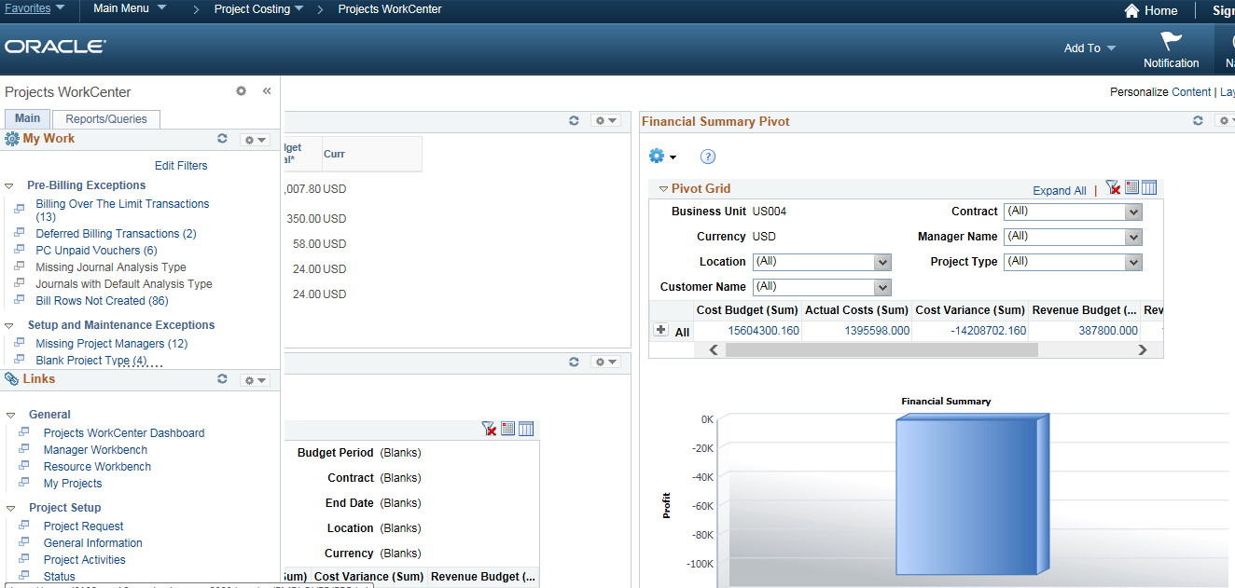
Pivot Grids
Pivots grids are based on PSQueries and can display the results in a grid format, a chart format, or both. Use the Pivot Grid Wizard to design how the page should appear.
Pivot grids can be added as pagelets (on a user’s Home page) and to the Queries tab in a WorkCenter.

Slide 8
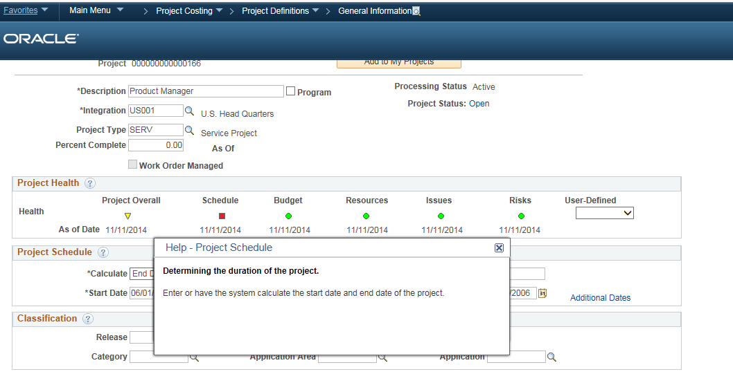
Embedded Help
Click the Embedded Help icon to open a secondary window with information about the page or section
Explains How to perform a specific task
Message appears in the Modal window which can be moved around the page

Slide 9
Alignment, Order and Positioning
Alignment
In PeopleSoft 9.1, all of the search and transaction fields were aligned to the left side of the page
In PeopleSoft 9.2, all of the search and transaction field labels will be right aligned to the fields
Order and Positioning
Order and position of fields on the page may have changed
Function is not impacted or changes as a result

Slide 10
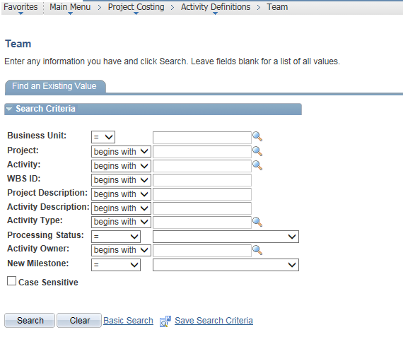
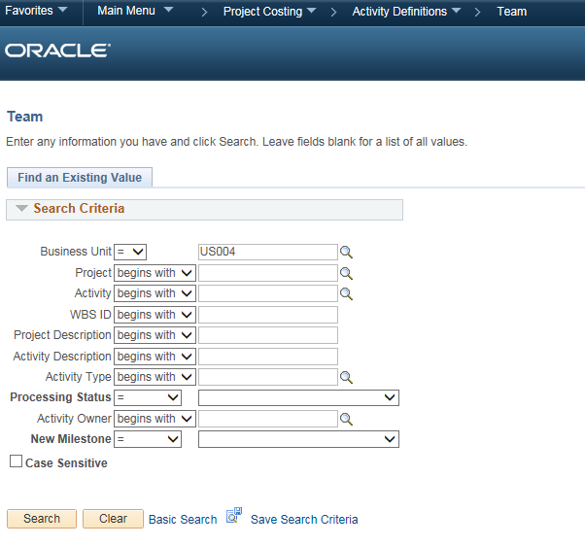
Alignment, Order and Positioning
PeopleSoft 9.1 PeopleSoft 9.2

Slide 11
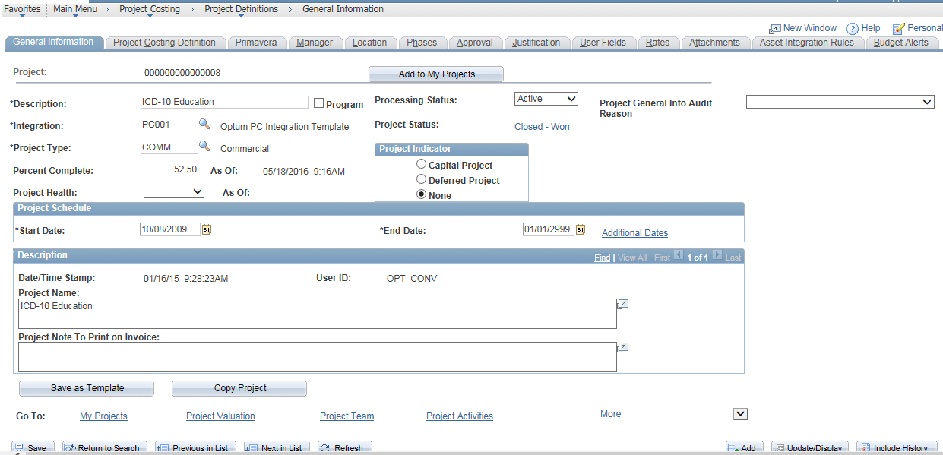
Alignment, Order and Positioning
PeopleSoft 9.1

Slide 12
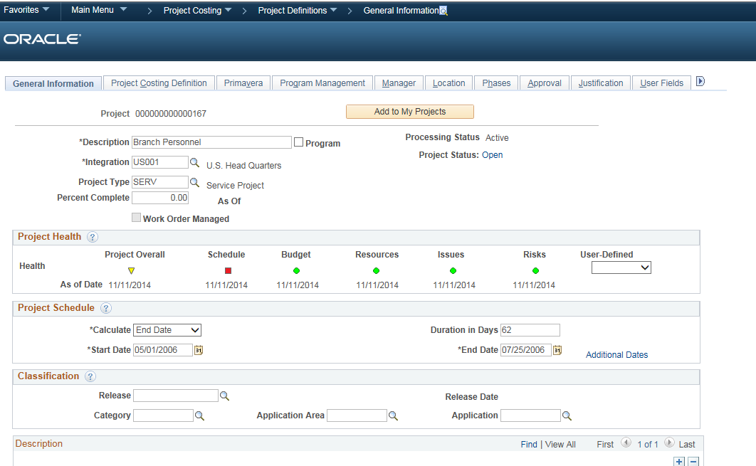
Alignment, Order and Positioning
PeopleSoft 9.2

Slide 13
PeopleSoft Import/Export Utility
Data Export Import Utility enables to map fields easily and interface both incoming and outgoing data between a source and a target data structure. The data set for the source and target can be in XML, flat file, or record format. Examples of typical uses for the utility are:
Importing external data from third-party systems
Exporting data to third-party systems
Creating payment files by format
Creating statutory audit files
The Data Export Import Utility mapping process enables to:
Export PeopleSoft database data to an XML file
Export PeopleSoft database data to a delimited file such as CSV
Import XML files into a PeopleSoft database
Import delimited files into a PeopleSoft database

Slide 14
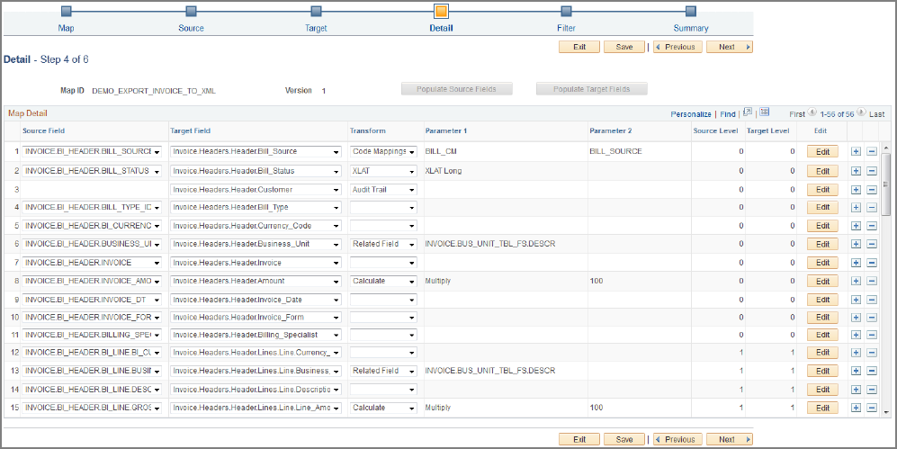
PeopleSoft Import/Export Utility
After defining PeopleSoft documents for the source and target, and having set up document relationships for records and fields, access the Map Definition component to use the mapping wizard
Set up transformation rules to apply to each field in the source and target data structures

Slide 15
Accessibility
Access PeopleSoft application content from mobile devices
Accessible with Apple iPad and other tablet devices
Certified on Safari browser running IOS version 4.2 or later
Certification enables Apple iPad browser to view virtually all of the PeopleSoft application pages

Slide 16
PeopleSoft 9.2 Project Costing Features

Slide 17
New 9.2 Changes for Project Costing
Custom Rates
Recognizing Revenue Separate from Billing
Supplemental Data
Enhancements to Manager Transaction Review (MTR)
Enhancements to the As Incurred Accounting Distribution search page
Feeder and Pricing Summarization
Variance Pricing
PeopleTools features such as WorkCenters, Dashboards have been added to improve employee productivity
Business Process Weaver
Data Migration Workbench
Bills that are entered directly into PeopleSoft Billing can be loaded to Project Costing during the Billing to Project Costing interface process (PC_BI_TO_PC)

Slide 18
New 9.2 Changes for Project Costing
Direct Journal transactions can be loaded to Project Costing during the Receivables to Project Costing interface process (PC_AR_TO_PC)
Activity Guides

Slide 19
Custom Rates
With release 9.2, custom rates provides with the means to create different cost and billing rate structures. Custom rates enables to create rates with multiple criteria, such as defining one custom rate based on job code and department, and another custom rate based on source type and supplier. In addition, rates can be loaded from an Excel spreadsheet.
Define and maintain custom rate definitions
Populate custom rates
Rate sets

Slide 20
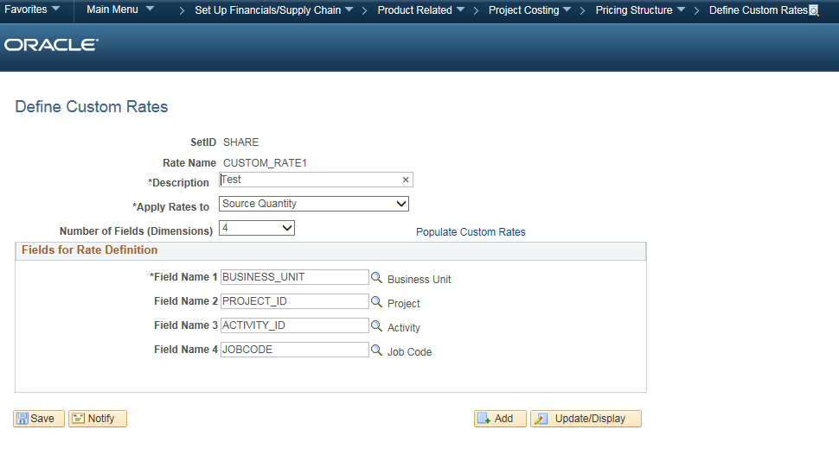
Custom Rates (Continued)
Define rates by as many as five different dimensions available in the project transaction table to accommodate complex rate structures

Slide 21
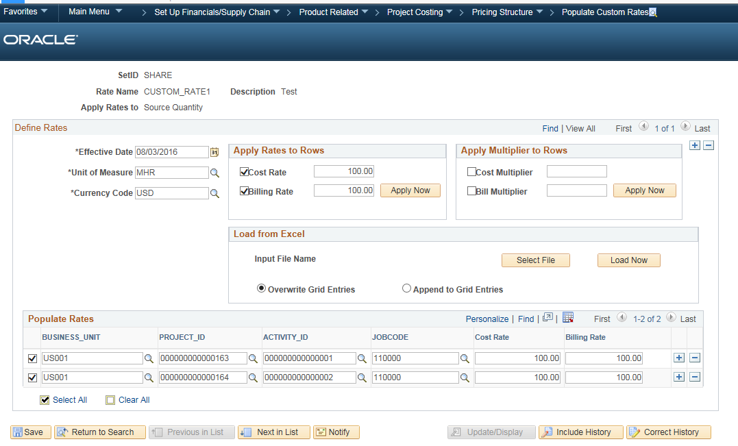
Custom Rates (Continued)
Populate custom rates

Slide 22
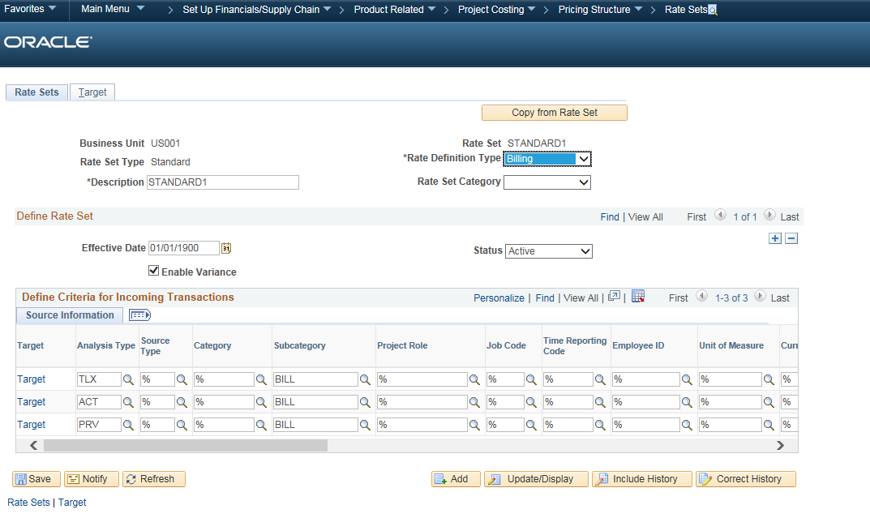
Custom Rates (Continued)
Rate Sets
After a custom rate is defined and the rates are populated, the custom rate can be associated with a rate set. When the Pricing process (PC_PRICING) runs, the appropriate custom rate value is used to calculate the cost of the priced transaction.

Slide 23
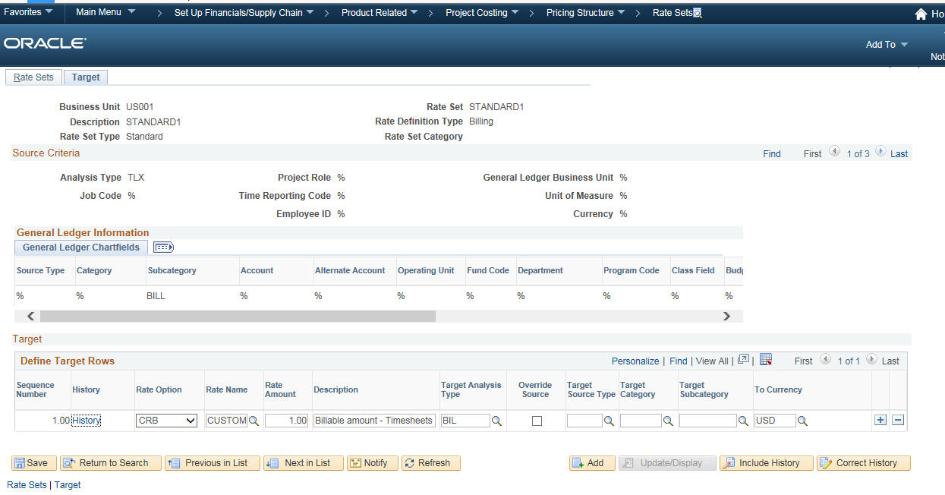
Custom Rates (Continued)
Two new rate options
CRC – Custom Rate using Cost Rate
CRB – Custom Rate using Bill Rate
New Rate Name column on the Define Target Rows grid

Slide 24


Slide 25
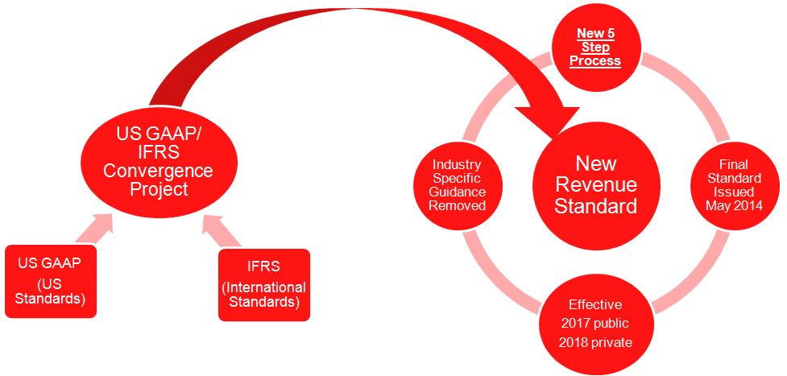
Functional Overview of the New Accounting Standard

Slide 26
Functional Overview of the New Accounting Standard – cont.
Current Generally Accepted Accounting Principles (GAAP) used in the United States are different from the International Financial Reporting Standards (IFRS) used in other countries
US GAAP/IFRS Convergence Project is sponsored by the FASB (The Financial Accounting Standards Board) which sets the accounting standards used in the United States and the IASB (The International Accounting Standards Board) which sets the reporting standards used by many other countries outside the US
Changes impact all public traded companies reporting to the Securities and Exchange Commission as well as other private entities that report financial results to others.
All entities that report revenue from customers that follow US GAAP are impacted by the change
Final standard was published in May 2014 with an effective date of 2017 for public companies

Slide 27
Supporting Transition to the New Revenue Accounting Standard
For rate-based contract lines, enhanced PeopleSoft Project Costing functionality allows separate calculations of revenue and billing based on cost, hours, or other input.
When creating a contract, users can opt to manage amounts and rates for revenue separately from those used for billing.
Alternatively, users can opt out of the new functionality, and amounts and rates used for billing will also be used for revenue.
New fields to capture the total contract price for billing and for revenue across all contract lines are included.
In the contract header, a new field, Contract Role, was introduced to be used to report revenue (and other financial metrics) as sales made directly to customers as a prime contractor or as sales made through intermediaries as a subcontractor.
New functionality included a new field on the contract line titled Bundle, which allows users to group related contract lines.
New functionality allowing separate configuration and processing of revenue and billing supports existing customer requirements and assists customers in their transition to the new revenue accounting standard

Slide 28
Recognizing Revenue Separate from Billing - Overview
Enhanced to allow customers the ability to define and manage revenue separate from amounts used to bill customers
One of the core concepts in the new revenue accounting standard is that individual contract line items be priced at amounts that reflect the value of the good or service being delivered to the customer
Price attributed to a contract line item for revenue recognition may be different than the price of the line item for billing
New fields were introduced to the contracts data structures allowing users to capture separate line level amounts for revenue, total revenue for the contract and total billing for the contract
‘Negotiated Amount’ in current 9.1 version has been renamed ‘Billing Amount’ and will be used for billing

Slide 29
Separate Pricing for Billing and Revenue Contracts and Project Costing
Billing and revenue allocation
Identifying total contract price for billing and revenue
Separate structures for allocating billing and revenue to the contract line
Attributes for grouping/bundling contract lines
Revenue rate sets in project costing
Defaults to reduce decision making and user error
Able to be applied on existing contracts
Optional at the contract level

Slide 30
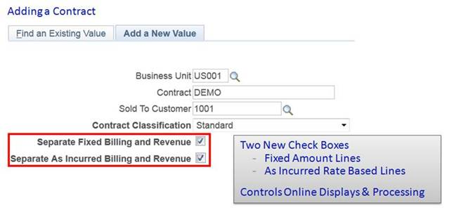
Separate Pricing for Billing and Revenue - Cont. Adding a Contract

Slide 31
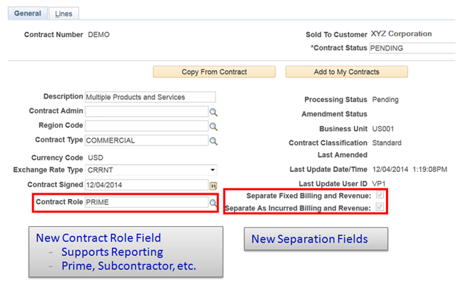
Separate Pricing for Billing and Revenue - Cont. New Separation fields and Control Role field

Slide 32
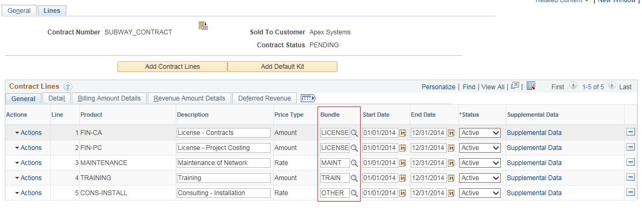
Separate Pricing for Billing and Revenue - Cont. New Bundle field to Group related contract lines
A new field called Bundle was added to the contract line. This field should be used to group related contract lines into a ‘bundle’ for revenue recognition.
Bundle field allows organizations to associate related contract lines by assigning a common attribute to the lines.
The field can be used to group and sort contract lines on pages and as an attribute for reporting.
Detailed revenue recognition functionality will continue to exist at the contract line level and customers will have visibility into the summation of this detail via the bundle assigned to the contract line.

Slide 33
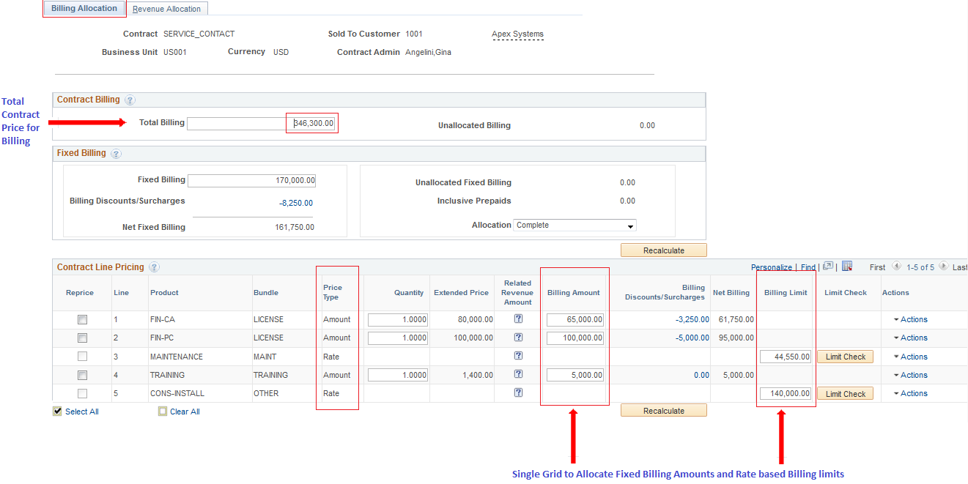
Separate Pricing for Billing and Revenue – Cont. Billing Allocation

Slide 34
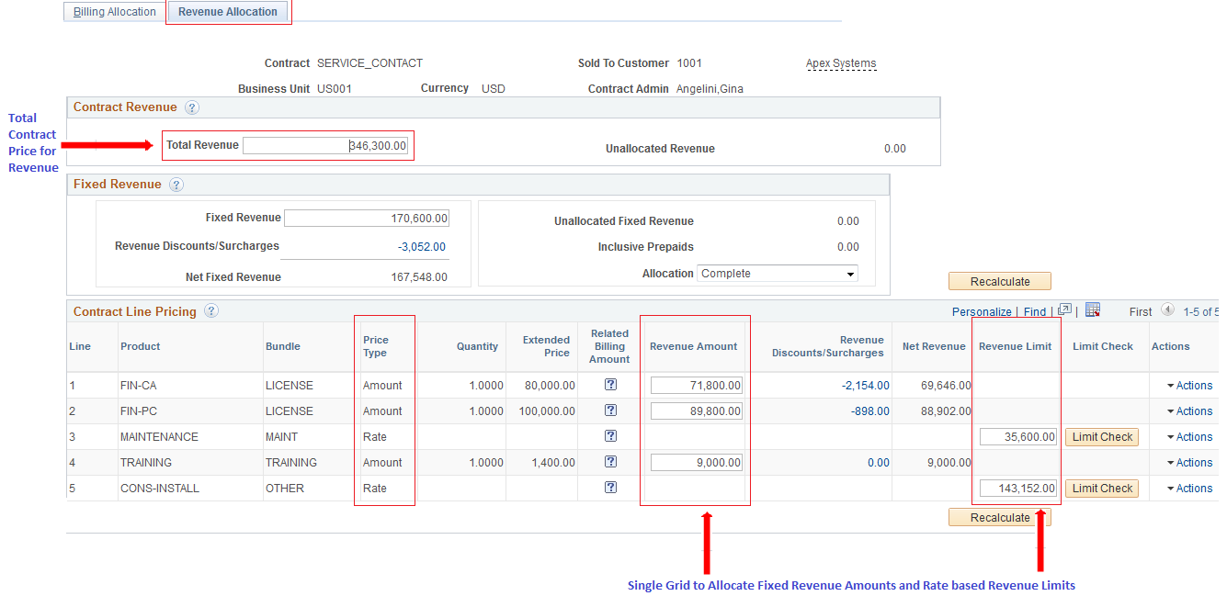
Separate Pricing for Billing and Revenue – Cont. Revenue Allocation

Slide 35
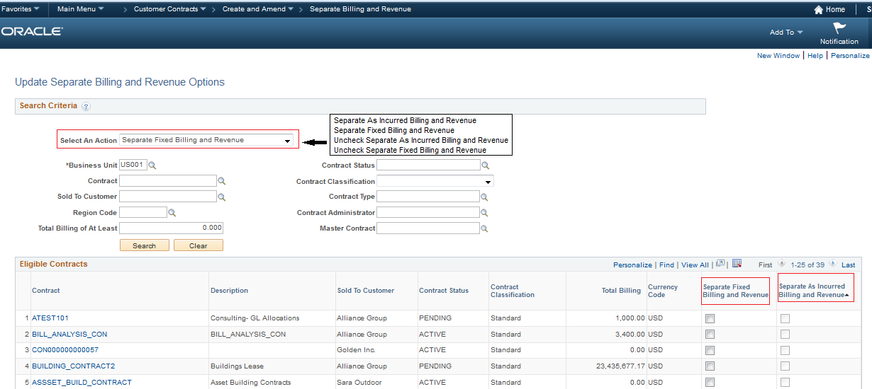
Update Separate Billing and Revenue Options

Slide 36
Separate Revenue Rate Sets for Rate Based Contract Lines
The PeopleSoft Contracts and Projects modules work together to allow separate configuration of revenue markups and rates per hour/quantity if the contract designates Separate As Incurred Billing and Revenue.
In project costing, rate sets are created with a rate definition type of Revenue and then assigned to contract lines. A single revenue rate set could be assigned to the contract line or more likely it would be included in a rate plan with other rate sets used to generate cost and billing
Revenue rate sets work similarly to billing rate sets with source criteria for project costing and general ledger fields. The difference is the analysis type created during the PC_PRICING process is REV instead of BIL.
BIL rows would also continue being generated, but represent only billing
In contrast, contracts that do not separate billing and revenue will only create BIL analysis types and they will be used for both billing and revenue recognition.

Slide 37
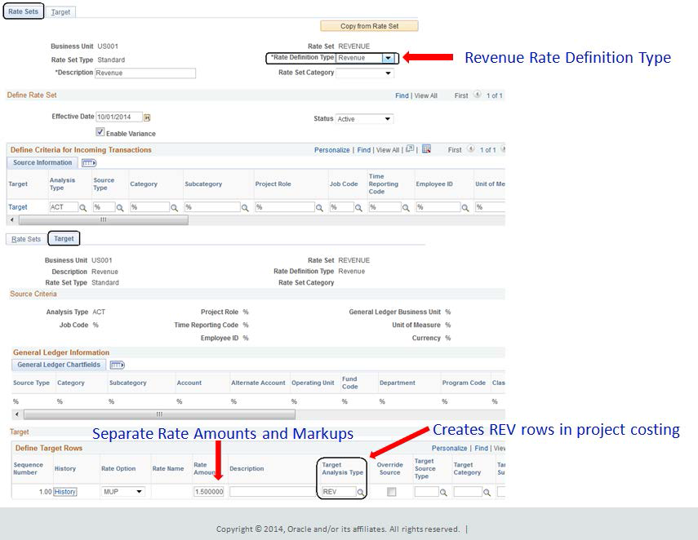
Separate Revenue Rate Sets for Rate Based Contract Lines – Cont.

Slide 38
Supplemental Data
Ability to add Project Attributes via configuration
Define a supplemental data record
Define and map supplemental data record fields to data store records
Specify details for supplemental data record fields
Define a supplemental data display group
Assign a supplemental data display group
Define conditions for display groups

Slide 39
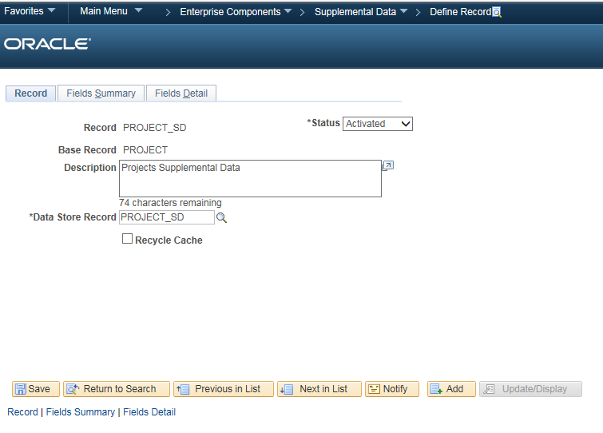
Supplemental Data (Continued)
Define a supplemental data record

Slide 40
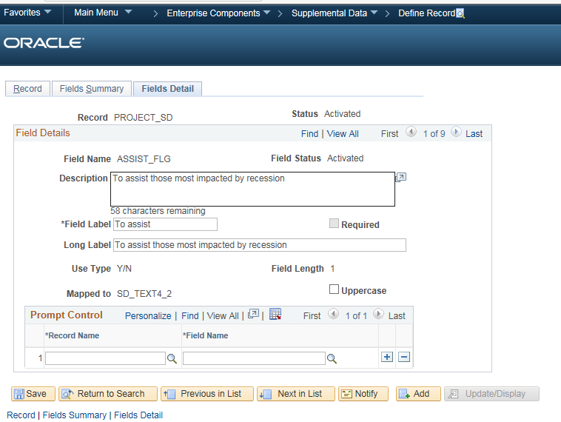
Supplemental Data (Continued)
Specify details for supplemental data record fields

Slide 41
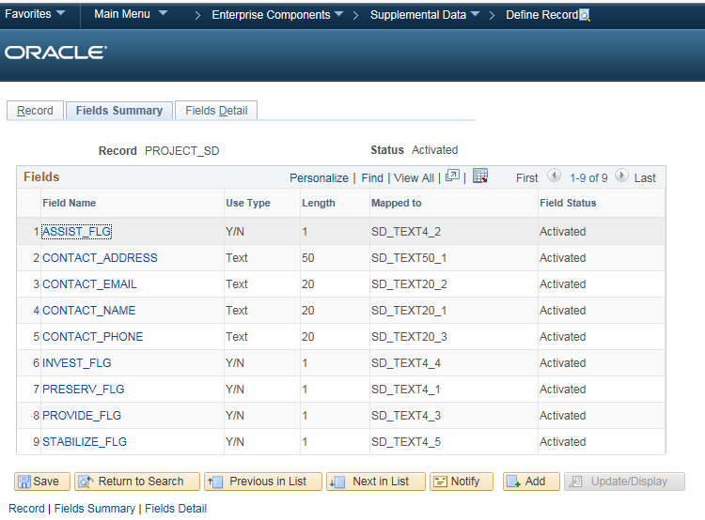
Supplemental Data (Continued)
Define and map supplemental data record fields to data store records

Slide 42
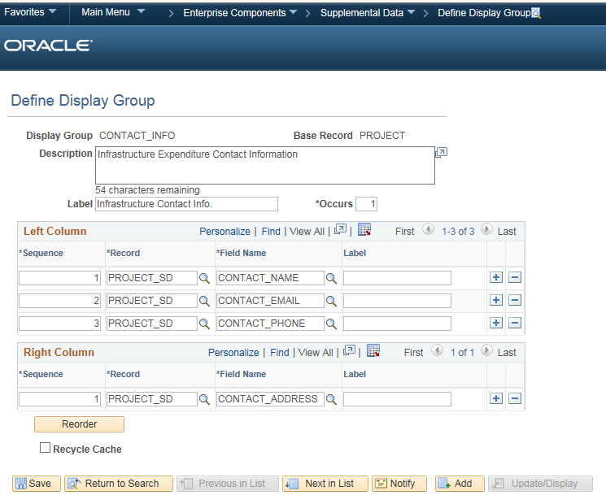
Supplemental Data (Continued)
Define a supplemental data display group

Slide 43
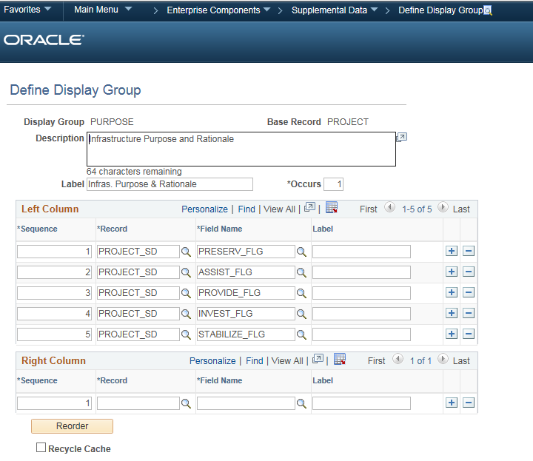
Supplemental Data (Continued)
Define a supplemental data display group

Slide 44
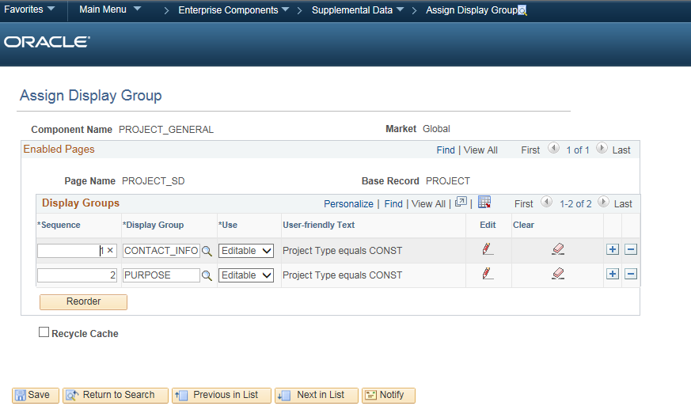
Supplemental Data (Continued)
Assign a supplemental data display group

Slide 45
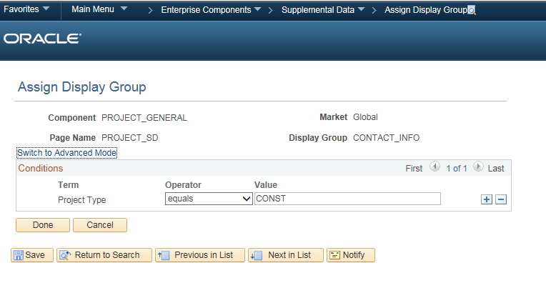
Supplemental Data (Continued)
Define conditions for display groups

Slide 46
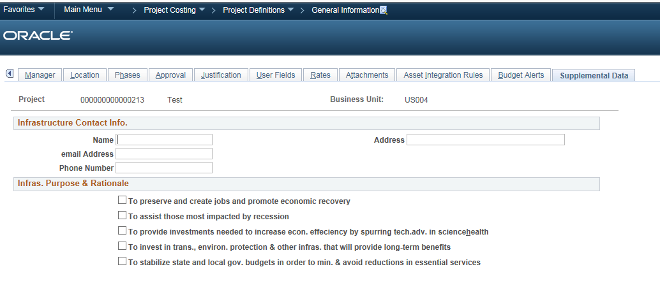
Supplemental Data (Continued)
Project General information

Slide 47
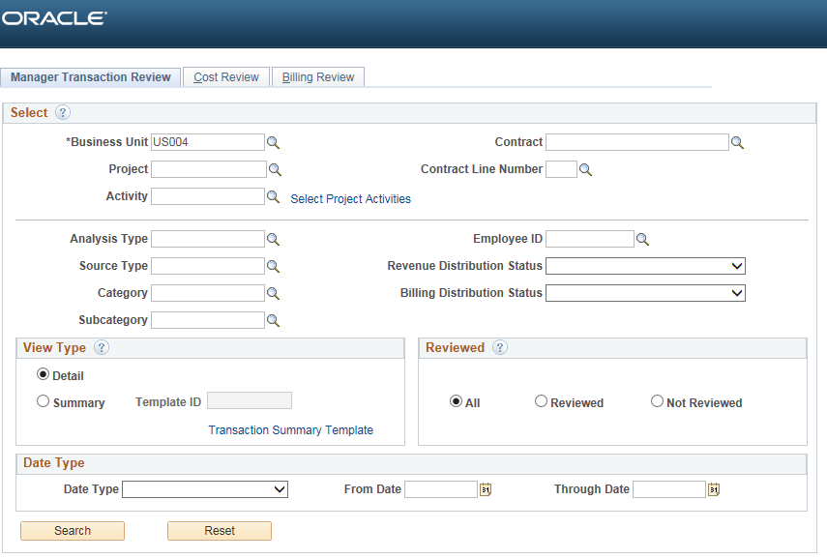
Manager Transaction Review
The Manager Transaction Review (MTR) feature has been enhanced to allow users to search billable transactions by contract and contract line.
New fields Contract and Contract Line number added as additional search fields

Slide 48
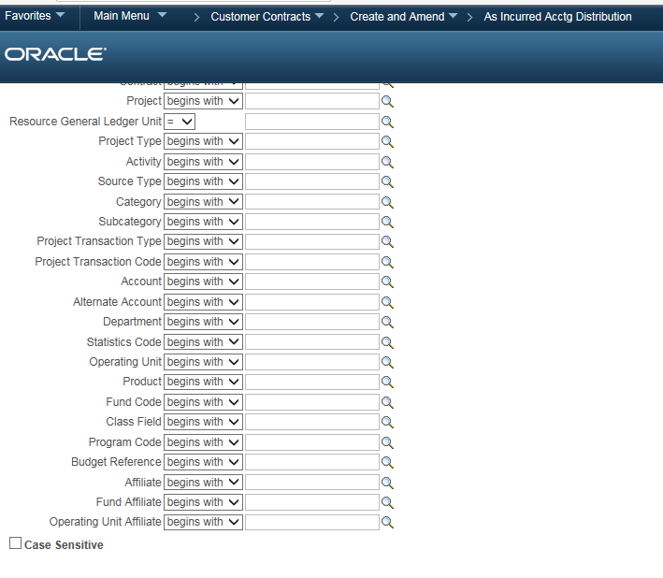
As Incurred Accounting Distribution Changes
Added new search fields

Slide 49
Feeder and Pricing Summarization Setup – Subsystem Transaction Summarization
Summarize separately by feeder system
General Ledger
Third-Party Loader
Reduce the number of rows loaded into PROJ_RESOURCE, Improving performance
Retain details on new tables

Slide 50
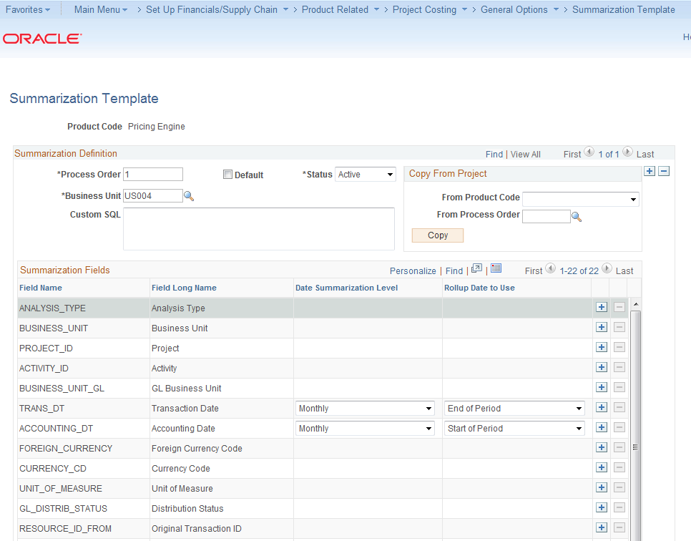
Feeder and Pricing Summarization – Cont. Setup – Pricing Summarization
Reduce the number of target rows generated by Pricing
Allow user to determine level of summarization
Summarization pricing output to eliminate excessive target transactions when rate stacking is applied
Reduce rounding issues created by pricing at too low a level

Slide 51
Variance Pricing Description
Enhance Variance Pricing to reduce the amount of effort involved in pricing and accounting for rate changes, and improve processing performance
Generate summarized variance output rows
Process all rate set types (cost, billing, cost/billing, and revenue)
Expand run control parameters for Variance Pricing to enable more control over the variance pricing transactions created
Reprice transactions for any project
Add an optional review page to enable users to examine the output of a rate change, and decide whether to accept the new calculations before proceeding

Slide 52
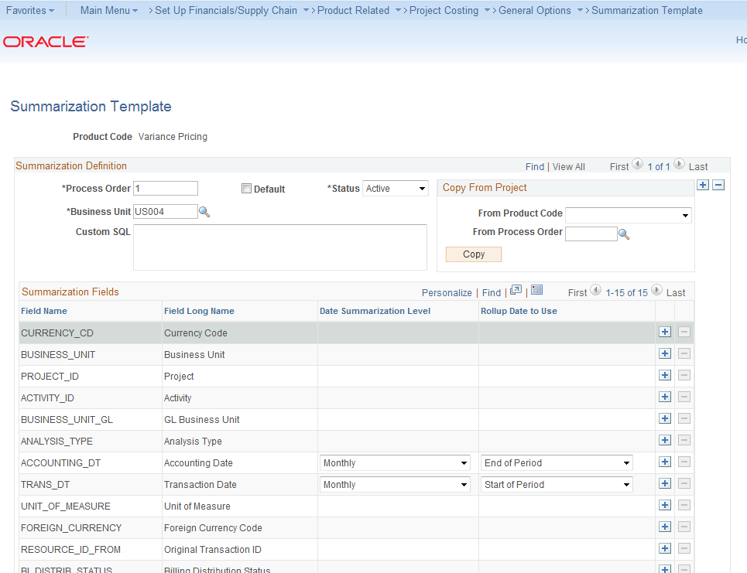
Variance Pricing – Cont. Setup – Variance Pricing Summarization
Generate Summarized variance output rows

Slide 53
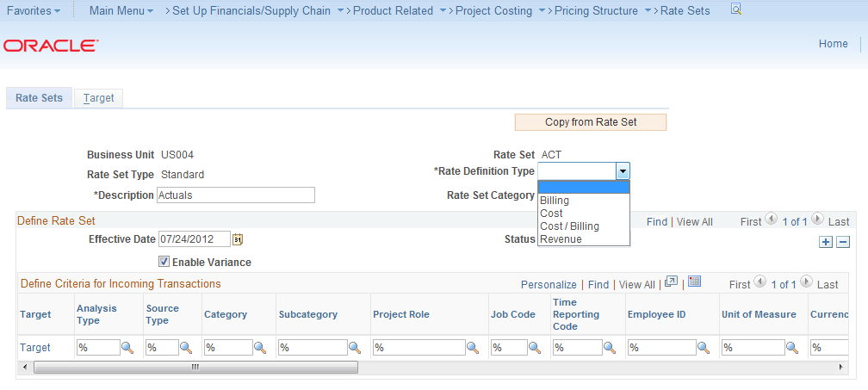
Variance Pricing – Cont. Setup – Rate Definition Types
Process all rate set types
Cost
Billing
Cost/Billing
Revenue

Slide 54
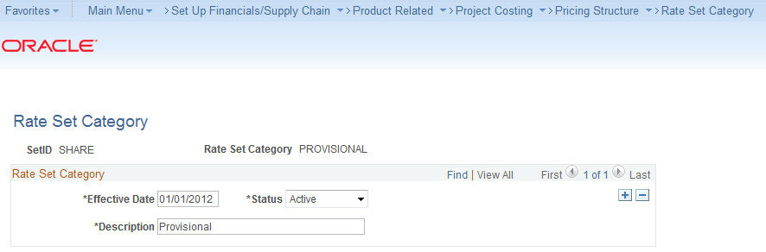
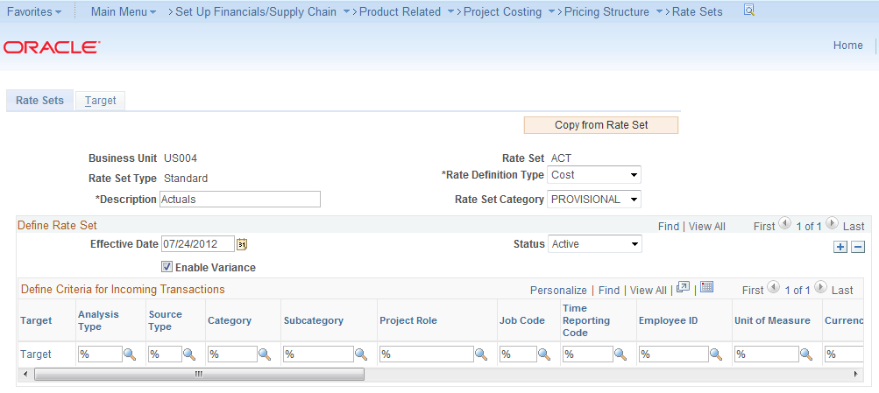
Variance Pricing – Cont. Setup – Rate Set Categories
Rate Set Categories group related rate sets for Variance Pricing

Slide 55
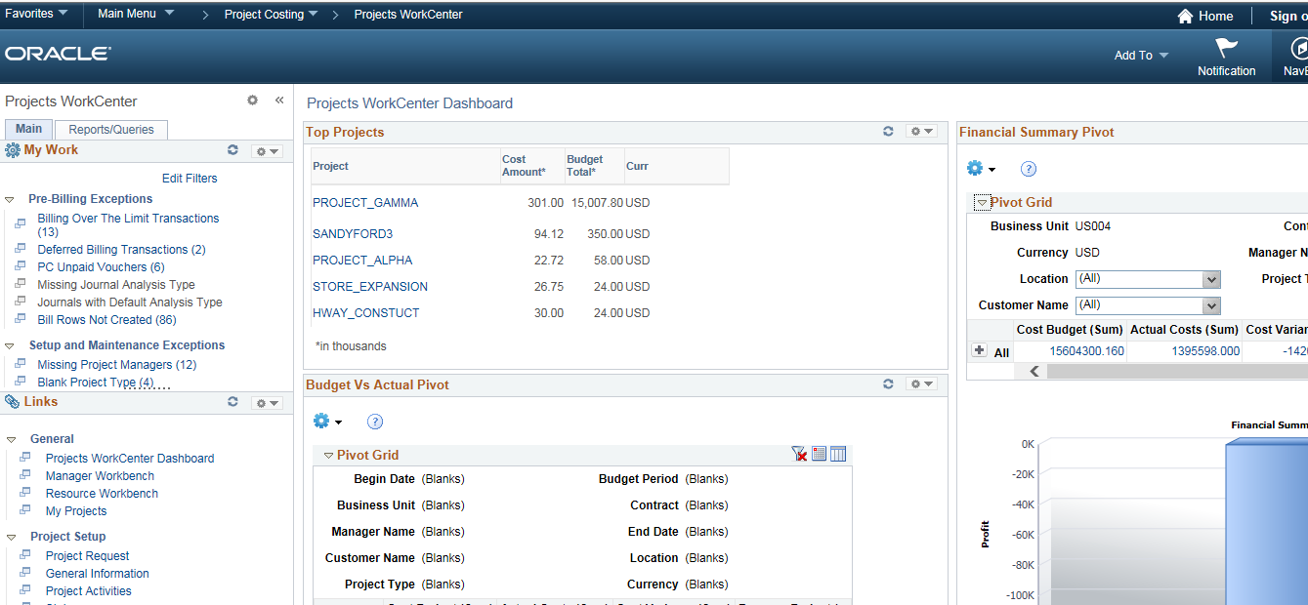
Project WorkCenter
The Project Costing WorkCenter is a central navigational component that is designed for the end user. The goal of the WorkCenter is to help an end user become more efficient by accessing frequently used pages and pagelets, and by keeping multiple windows open while performing daily tasks.

Slide 56
Business Process Weaver
PeopleSoft Business Process Weaver, a visualization and orchestration platform, enables organizations to model, manage, and support the stringing of scheduled processes (both delivered and custom), including the grouping of processes (PSJob) and user interactions.
Ability to string processes together and include user intervention in validating the results before or after specific processes
Billing Specialists will be able to run the Project Costing to Billing Interface Process via Business Process Weaver, which automatically initiates all of the necessary downstream processes.

Slide 57
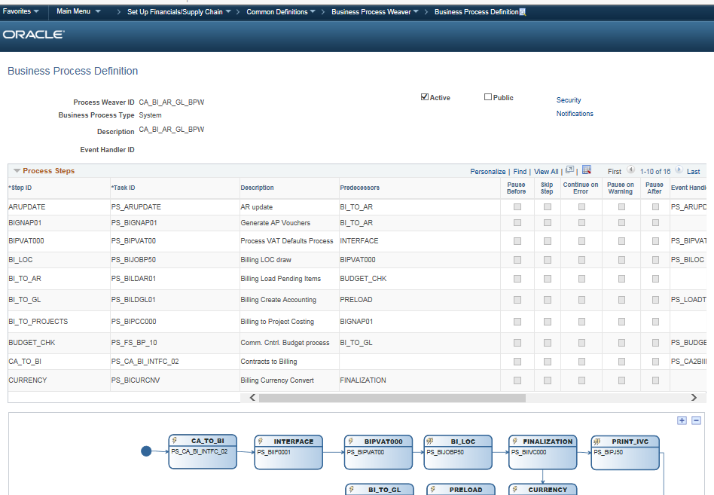
Business Process Weaver
Business Process Definition

Slide 58
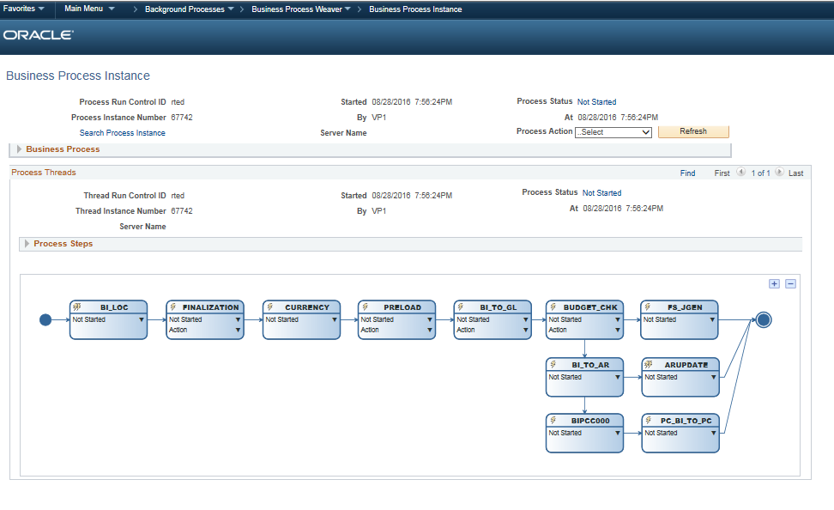
Business Process Weaver
Business Process Instance page
Use the Business Process Instance page to review and control the execution of business processes.

Slide 59
Data Migration Workbench for Application Data
Enables you to compare, validate, and copy application configuration data from one database to another using Application Data Sets (ADS) as its underlying transport technology
Effective alternative to Data Mover scripts
Any authorized developer or administrator can easily define application data sets using the PeopleSoft Pure Internet Architecture (PIA) and compare and copy the data
This functionality is introduced in 9.2 for the following applications:
Allocations
WorkCenters
Accounting Rules
From 9.2 Update Image 10 below are the applications which were included:
Project Custom Rates
Supplier Contract Data
Payables Options
SpeedCharts

Slide 60
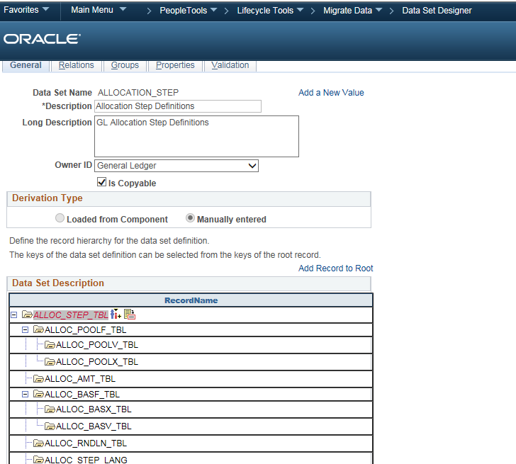
Allocation Step Definitions
GL Allocation Step Definitions

Slide 61
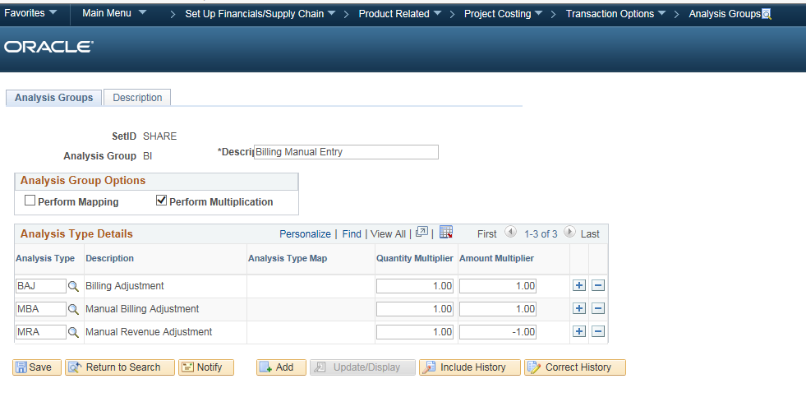
Integration with Project Costing
As of 9.2, Bills that are entered directly into PeopleSoft Billing can be loaded to Project Costing during the Billing to Project Costing interface process (PC_BI_TO_PC) (Billing Plan no longer needs to be entered.)

Slide 62
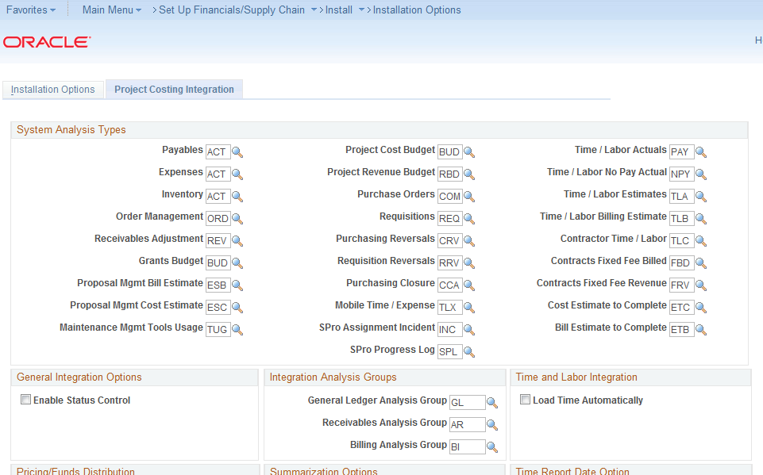
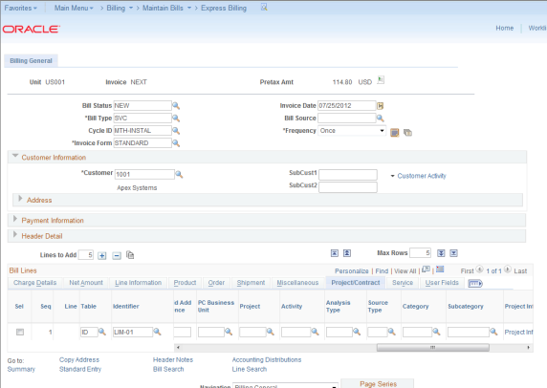
Integration with Project Costing – Cont.

Slide 63
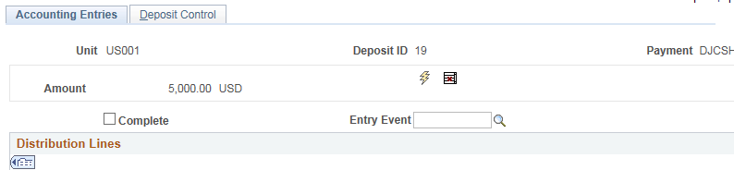
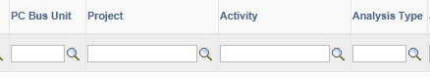
AR Direct Journal Integration with Projects
PeopleSoft AR 9.2 extends the AR to PC integration by interfacing AR direct journals to Project Costing. The interface process was modified to pick up direct journals from Receivables. Users are able to specify an analysis type while entering the direct journal which makes AR direct journal integration to PC consistent with other subsystems.

Slide 64
Activity Guides
Activity Guides allow application designers to define processes that guide users through a series of predefined actions to complete a transaction / Process.
Users are presented with a list of actions on their screen which need to be completed to finish a transaction/Process
The configuration allows to specify which steps are optional and which ones are required
Can even launch workflow and approval routing as part of the processing steps
Activity guides are very different from workflow.
Activity Guides – Perform Transactions
Workflows – Approve or Deny
Advantages
Lower Cost & Time needed for Training
Improve data quality to reduce reconciliation issues
Decrease process cycle times to improve cash flows
Measure Individual, Process & Business Performance

Slide 65
Customizations
Customizations | Description of changes | Carry forward
Project General Information | General Information page Description field renamed to Project Name Long Description field renamed to Project Note To Print on Invoice PROJECT_USER2 field label was modified from Field 2 to Project Indicator, This will be a Radio button page control field with values as Capital project, Deferred project and None User Fields page PROJECT_USER1 field label modified from Field 1 to Funding code PROJECT_USERAMT1 Field label modified from Amount 1 to Budget Hours and PROJECT_USERAMT2 Field label was modified from Amount 2 to Total Unbilled Hours A custom grid named “Cross References” was added with following fields: Source System ID, Project Cross Reference ID and Project System – All of these are made display only | Retrofit /Eliminate?
Activity General Information | User Field1 and User Field 2 renamed to Task type and Capitalization status A custom grid named “Cross References” will be added with following fields: Source System ID, Project Cross Reference ID, Activity Cross Reference ID and Project System – All of these will be made display only | Retrofit /Eliminate?
Review Project/Activity/Transaction Details | Created new page for Project/Activity/Transaction Interface additional details | Retrofit

Slide 66
Customizations
Customizations | Description of changes | Carry forward
Project Tree/Project Organization | Project Tree Project tree created using PROJECT_BU Structure to define programs, also known as Summary Projects Add projects to the PROJECT_BU tree using Tree Manager or from the Project Costing Definition page by specifying the tree name, parent tree node and effective date of tree. For integration/Conversion this happens automatically Project Organization Project Organization page to capture GL Chartfields for summary projects (programs)/Detail projects While creating the project in ERP from Project Management system, defaults the Project organization GL Chartfields (except Product) based on the values defined in the program organization GL chartfields | Retrofit
Employee Personal Data | New page created to load and maintain Employee chartfield data coming from Project management system. | Retrofit
PC Integration load validations | Below are the customizations done Functions developed to validate the integration load data New records created to log errors | Retrofit
Employee Chartfield Copy | Custom functionality developed to populate the Chartfield based on employee ID, used in the Transaction creation via Online/Interface/Conversion etc. | Retrofit

Slide 67
Customizations
Customizations | Description of changes | Carry forward
Transaction Adjustment | Below are the customizations done A new reason type named Transaction Updates Audit Reason is created and the new reason codes are created in the common definitions configuration for the Transaction Updates Audit Reason Backend to the online Transaction adjustments in projects, Customized to stop pricing from triggering automatically Custom Project Transaction Mass Upload/Adjustment program developed to load / adjust project costing transactions New Run control page created to upload the Transaction Mass upload/adjustment files Based on the Adjustment flag in the run control page, the program will proceed for Add or Adjustment Transaction Delivered Transaction loader will be called internally Delivered & Custom pricing process (PC_PRICING & OPT_PC_PRICE) will be called internally During Adjustment for unbilled transactions, while executing the pricing process the BI Distribution status for the Source and offset BIL row will be updated to “I”, New transaction BIL row will be priced and sent to billing. During Adjustment for Billed transactions, pricing process will be executed and the offset & new transaction BIL row will be priced | Retrofit

Slide 68
Customizations
Customizations | Description of changes | Carry forward
Project Costing Billing rules | Custom billing rule Setup Time rule Expense Rule Fixed fee Rule Fixed fee Revenue rule Fixed fee Billing rule Billing Methods Revenue Methods Do Not process Revenue flag Custom pages Rate Card Setup | Retrofit/Eliminate?
On-Line Wrapper | This is a delivered online wrapper AE used to call Project resource loader, Customizations done to call the Pricing process internally. | Retrofit
Pricing | Delivered process to price or reprice TLX/ACT/FTC transactions. Below are the customizations done Calls custom pricing process Rounding Of amounts Delete accounting, DST and UAR rows for NBILL entries Update Contract and Contract line number from rule header Update Rate multiplier , Rate divisor , Foreign currency ,Currency code & Priced rate Update resource sub category to BILL for sub category as 'X' Update GL distribution status based on the Do not process revenue flag Update BI distribution status for NBILL transactions which are priced and distributed | Retrofit/Eliminate?

Slide 69
Customizations
Customizations | Description of changes | Carry forward
Pricing(Cont.) | Custom Pricing engine developed to price rows based on the Custom billing rule setup This process will be used to split the BIL row created by the delivered pricing process into multiple BIL rows or BIL and OLT row as appropriate based on the cap hours/transaction level limit hours defined in the billing rules. Use the rule sequence to determine the next rule to apply while adjusting hours to fit under the cap. Foreign amounts, Resource amount and Resource quantity will be based on Cap rules. RESOURCE_ID_FROM will be set equal to the RESOURCE_ID of the source row. RESOURCE_ID of the OLT row will be the next sequential number derived by incrementing the field LAST_RESOURCE_ID present in table PS_INSTALLATION_PC by 1. RES_USER4 will contain the value of billing rule id which was applied. PRICED_RATE will be set based on the billing rule applied. | Retrofit/Eliminate?
Review and Manage Limits | Custom functionality developed to release the OLT rows and make them eligible for billing | Retrofit

Slide 70
Customizations
Customizations | Description of changes | Carry forward
Forecast Pricing | This is a bolt-on application engine process developed to price the Forecast transactions coming from the PM system Selects each of the forecast transaction rows individually and apply the corresponding rates for them Uses the Billing Rule to determine which rate to apply and in what sequence to run them Time Reporting billing rules to be applied to users' forecast time entries that are associated with the project Calculates the forecast amount based on the user rates defined at Billing Rule level Updates the transaction row with the billing rule id to identify which rule is applied for the transaction | Retrofit
Fixed Fee Pricing Process | This is a bolt-on application engine process created to Price the fixed fee transactions Creates the Billable rows for fixed fee amount based on the Event Date Creates the Revenue rows for fixed fee amount based on the Accounting Date Custom pages developed to capture Fixed Fee Amount, Percentage, Event Type, Event Status, Event Date, Amount, Billing Plan Event Note, Accounting Date, Revenue Plan Event Note, Billing Methods , Revenue Methods etc. | Retrofit
Fixed Fee Percentage Update | This is a bolt-on application engine process which currently is only run to update the accounting dates of events for FF rule / FF Revenue Rules that use Milestone type | Retrofit

Slide 71
Customizations
Customizations | Description of changes | Carry forward
Percentage Calculation Process | This is a bolt-on application engine process created to update the percentages at the Activity/Project level. Project Percent Complete calculation is based on the Budget Hours (User Amount1) Activity Percent Complete calculation is based on the Planned Hours (Assigned Work) Whenever the hours got changed by the interface process, the percentage complete calculation runs to update the percentage complete at project and activity level Percent Complete Audit Reason is introduced to capture the reason codes if the user overrides the percent complete at project level (or) activity level | Retrofit
Variance pricing process | This is a delivered variance pricing application engine process , Below are the customizations done Custom Rate Variance history page to capture the new rates Custom process to be called from the delivered process which will use the custom rate page to apply the new rates retroactively It will create new transaction rows by Creating Reversal of the Old Transaction Amount The new transaction rows which require manger approval can be reviewed in Variance pricing review page. Manager can approve or reject the transactions | Retrofit

Slide 72
Customizations
Customizations | Description of changes | Carry forward
Accounting Rules Engine process | This is a delivered process to create accounting entries for Project costing rows. Below are the customizations done Update the event status to Ready Call the custom accounting process internally Custom Accounting rules engine developed to Update the billing BU in project costing accounting tables Update BU GL information present at project transaction table to BI Interface etc. | Retrofit
PC Elimination Entries | This is a bolt-on application engine process developed to create elimination entries for INTER/INTRA projects. Custom elimination matrix created to capture the elimination BU and related chartfields. | Retrofit
PC Where Clause Generation | Functionality to generate the where clause used by several processes including pricing, accounting rules engine etc. | Retrofit
Project costing Auditing | Audit enabled on Billing rule Time Reporting Transactions Grid Project activity status Project team page, project manager check box As incurred accounting distribution page Allocations etc. | Retrofit

Slide 73
Customizations
Customizations | Description of changes | Carry forward
PC Price adjustment | Price adjustment setup for PC module, Custom pages/records are created to capture the %increment for a project at billing rule level in PeopleSoft. This information will be used for reporting purposes, monthly Query will be used to notify Finance to take action, if needed. | Retrofit
Accounting Entry Definition | Customized the accounting entry definitions to restrict creation of accounting entries for analysis group PSCST | Retrofit
PC Enhanced Search fields | Added additional search fields(Project Source System , Project Cross Reference ID & Contract Cross Reference ID) on the below components: Project General Information Project Activities Project Team Project Status | Retrofit
Manager Transaction Review | Made the Revenue distribution field as hidden and added Revenue status(GL distribution status) Added GL Distribution status field next to Billing Status field on Billing review page | Retrofit

Slide 74
Customizations
Customizations | Description of changes | Carry forward
Custom PC Setup Information | New mapping page created to Maintain the Source system Id, Business Unit, GL business unit values, used during integration load. | Retrofit
Custom AR distribution Mapping | AR Distribution mapping page , used to maintain the AR account code. | Retrofit

Slide 75
Interfaces/File uploads
Interface | Description of changes | Carry forward
Project Costing Integration Load | This is a bolt-on application engine process developed to load the project costing data coming from OA/Plan View/Concur systems in to Interface/Main tables. | Retrofit
Project Costing Data conversion Process | This is a bolt-on application engine process developed to load the project costing data in interface/Main tables from legacy system, Below are the files which gets loaded. Resources Projects Activities Activities Team Time Bill Rule TE Bill Rule –User Filter TE Bill Rule –Task Filter TE Bill Rules-Rates EXP Bill Rule Fixed Fee Bill Rule, Bill Plan and Revenue Plan Time-Expenses- Forecast Transactions | Retrofit
Project Costing Data Load | This AE will be used to load Project Costing Consolidated Data like Projects,Activities,Assigning Contracts, Bill/Revenue Plan Events, Creating and Mapping Resources, Mapping Rates at Project Team level and Creating Transactions for the particular Project and Activity. | Eliminate
Project Transaction Mass Upload/Adjustment | This is a bolt-on application engine process developed to load / adjust project costing transactions(Timesheet/Expenses) | Retrofit

Slide 76
Interfaces/File uploads
Interface | Description of changes | Carry forward
Multi GL Accounting | This is a bolt-on application engine process developed to load additional accounting rules | Retrofit
DMT PC conversion | This is a bolt-on application engine process developed to load the project costing data in interface/Main tables from legacy system, Pre validation process to capture the errors before hand and generate reports to take appropriate action. | Retrofit
Project Costing - Multi-GL BU(DMT) | This is a bolt-on application engine process developed to load additional accounting rules | Retrofit
General Projects Interface | This is a delivered process to load project and activity data into PeopleSoft Project Costing tables. Below are the customizations done. Contracts Projects Linking Creation of As incurred accounting rules Project tree updates etc. | Retrofit
Load Transaction Process | This is a delivered process run to load Third-Party Transactions to send transactions to the Project Transaction table from the Interface table. Below are the customizations done. Delete all successfully loaded transactions from custom interface record Insert data in to PS_OPT_PROJRES_REC etc. | Retrofit

Slide 77
Interfaces/File uploads
Interface | Description of changes | Carry forward
Billing to Projects Process | This is a delivered process to update billing information to PC. Modified the AE to update the BI_DISTRIB_STATUS for modified row sent from billing worksheet. | Retrofit
Project costing ETL integration(OA) | This is a bolt-on application engine process developed to create and send mapping files to ETL for OpenAir data. | Retrofit
Project costing ETL integration(PV) | This is a bolt-on application engine process developed to create and send mapping files to ETL for PlanView data. | Retrofit

Slide 78
Security
Pages
All the new pages delivered as part of the PS 9.2 needs to be assigned to custom permission lists
Process
Any new process introduced in PS 9.2 needs to be assigned appropriate process groups.
Review security matrix

Slide 79



Questions?

Slide 80
Thank you
Contact information
Vinod Kumar Malothu
#+91 40-396-85223
vinod_malothu@optum.com

